Slide 1









AWS EC2
STEMUP
Elastic Cloud Compute

Slide 2
AWS EC2 (Amazon Elastic Compute Cloud) is a cloud service that provides resizable virtual servers, called instances, which you can use to run applications.

Slide 3


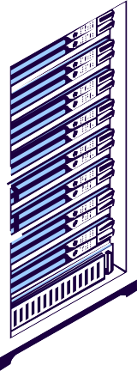






Imaoftine you're runninoft a business and need a server to host your website or application.
STEMUP
Instead of buyinoft and manaoftinoft physical servers, AWS EC2 lets you rent virtual servers in the cloud.
These virtual servers are called instances.

Slide 4





STEMUP
You Can Configure several options...

Slide 5



OS RAM CPU
Disk Space Network/Firewall
How to access the machine?

Slide 6

Instance Type: Select the hardware capacity (e.oft., CPU, memory).
AMI (Amazon Machine Imaofte): Choose the operatinoft system and software (linux, mac, windows).
STEMUP
Storaofte: Confiofture the type and size of storaofte (e.oft., EBS volume).
Security Groups: Set up firewall rules to control inbound/outbound traffic.
Key Pair: Create or use an existinoft key pair for SSH access.

Slide 7

Network Settinofts: Confiofture VPC, subnet, and assioftn public or
private IP addresses.
IAM Role: Attach an IAM role for permissions to access other AWS resources.
STEMUP
User Data: Add scripts to be executed when the instance starts.
Elastic IP: Optionally associate a static IP address for consistent public access.

Slide 8
Creating our EC2 Instance

Slide 9
Userdata script to install and run Apache Webserver
#!/bin/bash
sudo yum update -y
# Install Apache web server (httpd) sudo yum install -y httpd
sudo systemctl start httpd sudo systemctl enable httpd
# Create a simple HTML file to verify the web server is running
echo "<html><h1>Welcome to Apache Web Server on Amazon Linux!</h1></html>" >
/var/www/html/index.html

Slide 10

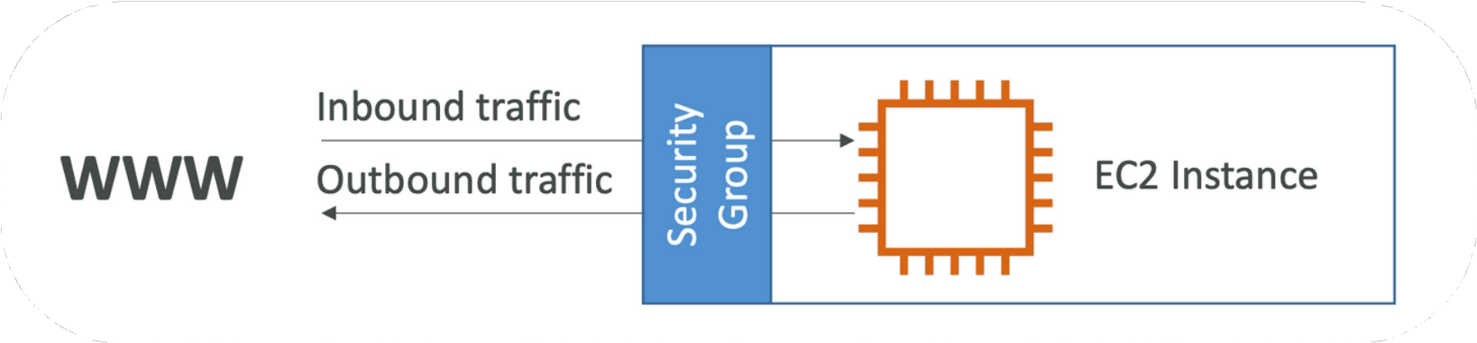

Security Groups: Network firewall rules that control inbound and outbound traffic for instances.

Slide 11
Important points about security groups
Region specific
Only ‘Allow’ rule (but no deny rule)
All inbound traffic blocked and outbound allowed by default.
You define rules for specific:
Protocols (like HTTP, HTTPS, SSH, etc.).
Port numbers (e.g., port 80 for HTTP, port 22 for SSH).
IP addresses or ranges (e.g., allow traffic only from a specific IP or range of IPs).
If you allow incoming traffic on a specific port (e.g., port 80 for HTTP), the outgoing response traffic is automatically allowed without an explicit outbound rule.

Slide 12

Some ports you should be aware of:
HTTP (Port 80) – Unencrypted web traffic.
HTTPS (Port 443) – Encrypted web traffic (SSL/TLS).
SSH (Port 22) – Secure remote access to servers (Linux/Unix). FTP (Port 21) – File Transfer Protocol (unsecured).
SFTP (Port 22) – Secure File Transfer Protocol.
SMTP (Port 25) – Simple Mail Transfer Protocol (email sending).
RDP (Port 3389) – Remote Desktop Protocol (Windows remote access). MySQL (Port 3306) – MySQL database connections.
PostgreSQL (Port 5432) – PostgreSQL database connections.
DNS (Port 53) – Domain Name System (converts domain names to IP addresses).

Slide 13


How to SSH into EC2 instance?
SSH allows you to control/access a remote machine.

Slide 14
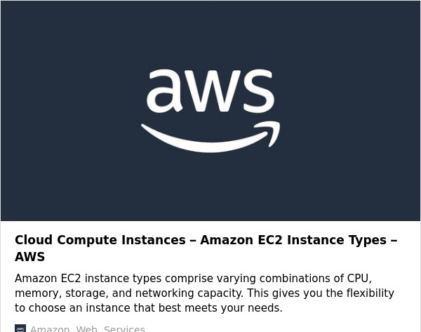
Instance Types

Slide 15





Case 1: Small Website or Blog
Suitable Type: t3.micro or t3.small (General Purpose)
Case 2: E-Commerce Application
Suitable Type: m5.large or m5.xlarge (General Purpose)
Case 3: Real-Time Video Rendering and Streaming (Accelerated Computing)
Instance Type: g5.12xlarge or g5.24xlarge
Case 4: In-Memory Database for Real-Time Analytics (Memory Optimized)
r6g.16xlarge or x2idn.32xlarge (Memory Optimized)

Slide 16
Purchasing Options

Slide 17
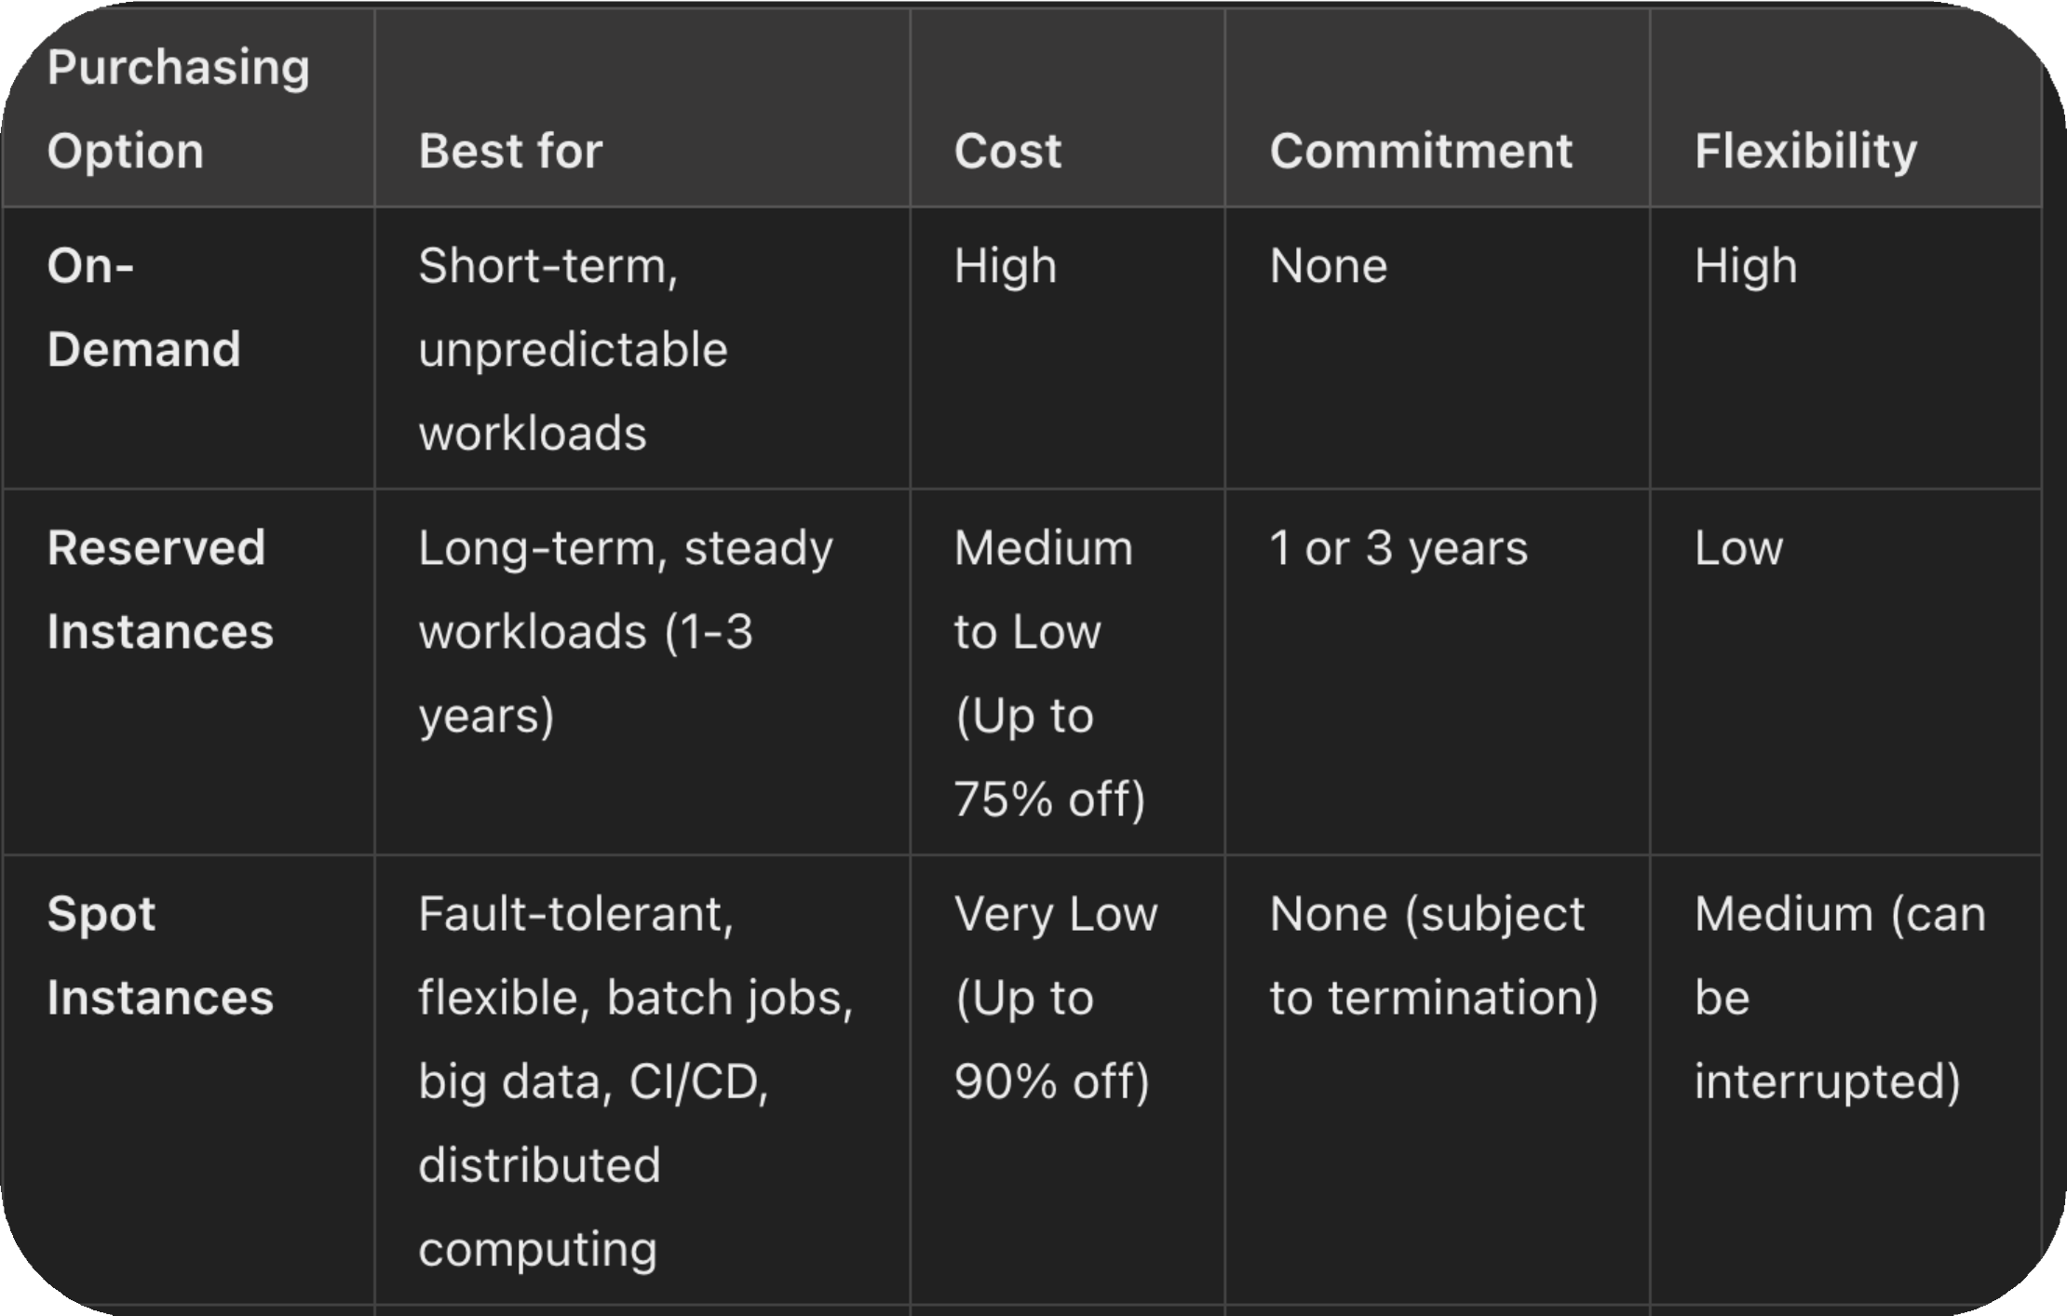

Slide 18
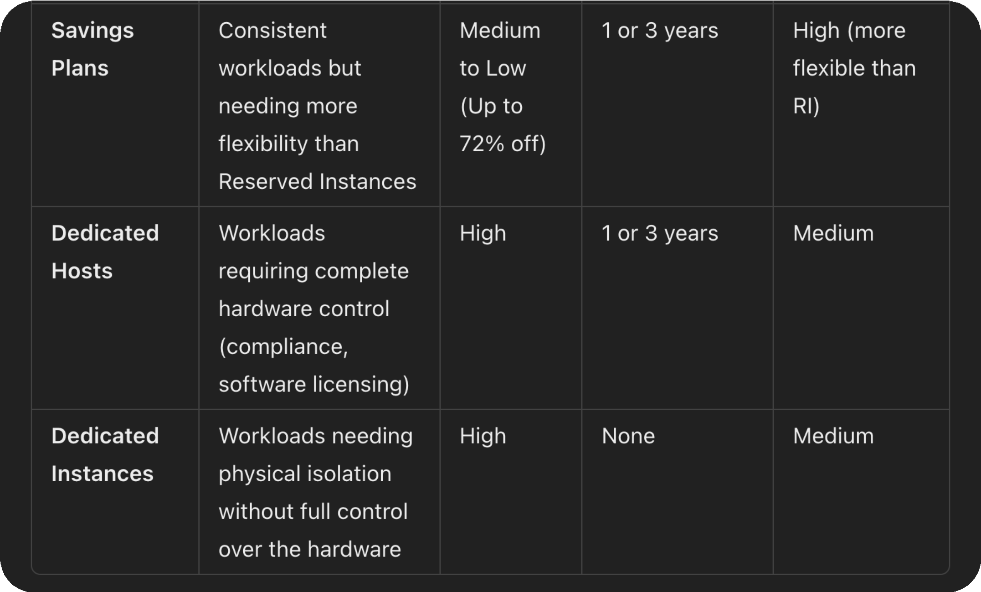

Slide 19

For short-term, unpredictable workloads, On-Demand is the best.
For long-term, predictable workloads, Reserved Instances or Savings Plans can save you significant costs.
If you have flexible, fault-tolerant workloads, Spot Instances offer the most cost-effective option, while Dedicated Hosts or Dedicated Instances provide hardware isolation and compliance benefits.

Slide 20
